Slide 1

Internship Presentation
Company - Cognizant Technology Solutions
Project – Building ETL Process Vendor
Internal Guide – Prof. Rashmi B C, Department of AI&ML
Abhishek Mahato – 1RN21AI008

Slide 2


Introduction of the Company
Role: Cognizant is an American multinational information technology consulting and outsourcing company. It helps businesses modernize technology, reimagine processes, and transform experiences to stay relevant and competitive.
Mission: To engineer modern businesses that improve everyday lives by leveraging technology and innovation.
Objectives:
Transform experiences with hyper-personalized solutions.
Reimagine processes through automation and technology.
Modernize technology to create value from data and cloud solutions.
Build relationships with market-leading companies globally.
Established: January 26, 1994
Type: Publicly traded company (NASDAQ: CTSH)
Headquarters: Teaneck, New Jersey, United States
Website: https://www.cognizant.com/

Slide 3
Cognizant's Key Activities and Achievements
Key Activities:
Digital Transformation
Consulting Services
AI and Automation
Cloud Services
Cybersecurity
Key Achievements:
Recognized as a Top Provider in Outsourcing and Consulting categories by CGT.
Named Customer Satisfaction Leader by CGT.
Ovum Decision Matrix recognized Cognizant as "Market Leader" in Outsourcing Testing Service Providers.
Awarded CGT Readers’ Choice Award for the ninth consecutive year.
Named a Leader in Business Intelligence Services by Forrester Research, Inc.
Placed in IDC MarketScape as a Leader in IT and BPO Services.

Slide 4
Internship Objectives
Primary Goal: To develop and implement ETL processes for building a data warehouse tailored to business requirements.
Key Responsibilities:
Build Data Warehouse: Create a comprehensive data warehouse for sales details, including net sales, product units, order count, discounts, average order value, and average order size.
Centralized Repository: Develop a centralized repository for data collection and reporting across multiple geographies, focusing on parts and vendor details.
Create ETL Processes: Design and implement ETL processes to load data into the data warehouse on a daily, monthly, yearly, and on-demand basis.
Expected Outcomes:
Enhanced Decision Support: Improved decision-making capabilities through detailed sales reports.
Centralized Data Access: Efficient data collection and reporting from various agencies.
Reliable Data Loading: Consistent and accurate data loading and retrieval processes.

Slide 5
Role and Responsibilities
Develop ETL processes for data loading and retrieval.
Create a comprehensive data warehouse for sales reporting.
Develop a centralized repository for data collection and reporting.
Perform data analysis to support business decision-making.
Ensure the reliability and performance of the data warehouse.
Prepare and maintain documentation for ETL processes and architecture.
Collaborate with the project team to meet business requirements.

Slide 6
Problem Statement
Problem:
Need to build a data warehouse for sales reporting.
Require a centralized repository for data collection and reporting.
Need to create ETL processes for data loading and retrieval
Solution:
Develop a comprehensive data warehouse for sales details.
Create a centralized repository for data collection across geographies.
Implement ETL processes for daily, monthly, yearly, and on-demand data loading.

Slide 7
Technical Architecture
Physical Architecture:
Presentation Layer: Interface for user interaction.
Business Logic Layer: Processes and functions to handle business rules.
Data Access Layer: Manages data storage and retrieval.
Logical Architecture:
Processes: Activities and functions required to provide user services.
Implementation: Software, hardware, or firmware to execute processes.
Independence: Logical architecture is independent of specific technologies and implementations.

Slide 8
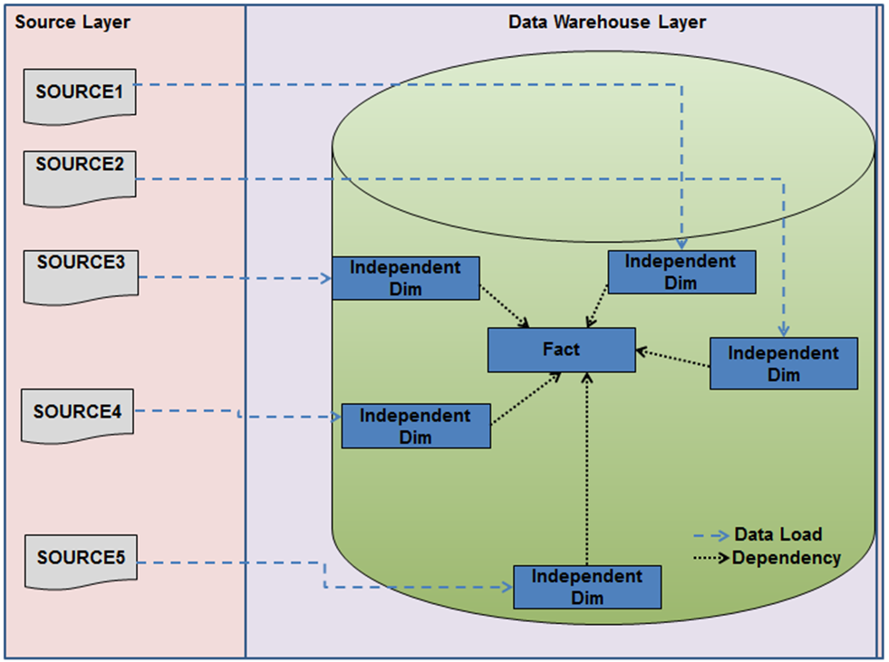
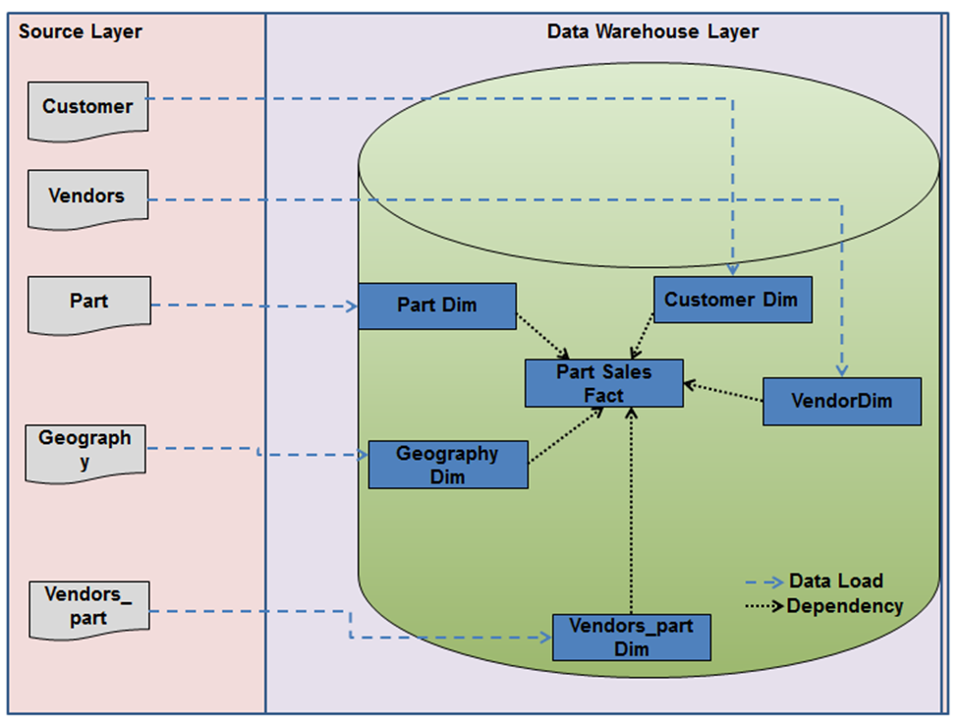
Technical Architecture
Physical Architecture
Logical Architecture

Slide 9
Key Technologies Used
ETL Tool: DataStage
Data Warehouse: Custom-built for sales reporting
Database Management System: SQL-based for structured data storage
Data Integration: Tools for integrating data from various sources

Slide 10
Key Learnings
ETL Processes: Understanding the importance of ETL processes in building and maintaining a data warehouse.
Data Warehouse: Recognizing the role of a data warehouse in enhancing decision support and generating reports.
Centralized Repository: Learning about the need for centralized data access for efficient reporting and data collection.
System Architecture: Gaining insights into physical and logical architecture layers.
Table Definitions: Understanding different types of tables and their mappings in a data warehouse.
Functional Requirements: Identifying key functional requirements for building a data warehouse, centralized repository, and ETL processes.

Slide 11
Challenges Faced
Complexity in Building Data Warehouse: Ensuring comprehensive and accurate data integration for sales reporting. This involves handling large volumes of data and maintaining data consistency.
Centralized Repository Development: Managing data collection and reporting across multiple geographies. It requires coordinating data from various sources and ensuring seamless access.
ETL Process Implementation: Designing and maintaining efficient ETL processes for daily, monthly, yearly, and on-demand data loading. This includes optimizing performance and ensuring data quality.

Slide 12
Conclusion
Successful ETL Implementation: The project demonstrated the ability to design and maintain efficient ETL processes that handle data loading on a daily, monthly, yearly, and on-demand basis. This ensures that the data warehouse is always up-to-date with the latest information, providing reliable data for analysis and reporting.
Enhanced Decision Support: With the creation of a detailed data warehouse, the project has significantly enhanced the decision-making capabilities of the client. The data warehouse includes various sales metrics such as net sales, product units, order count, discounts, average order value, and average order size, which are essential for forecasting and evaluating product sales across different branches.
Centralized Data Access: The development of a centralized repository has streamlined data collection and reporting processes. This centralized system allows for efficient data access from multiple geographies, ensuring that all relevant data is available in one place. This is particularly beneficial for generating various reports and making informed business decisions.
System Reliability: The project has ensured the reliability and performance of the data warehouse. By maintaining comprehensive documentation and implementing robust ETL processes, the system is designed to handle large volumes of data and provide consistent performance. This reliability is critical for the ongoing success of the data warehouse in supporting the client's business needs.

Slide 13
THANK YOU

